Slide 1

IT-648: IT Risk Management
Week 14
Sonja Streuber

Slide 2
Agenda
# | Topic | Reading | Due 11:59 pm CST on Blackboard
14 | Policies, Standards, and Guidelines: Writing a policy, Impact assessment and vetting, Policy review, Compliance, Key Policy Issues | Agrawal 13 Other materials on Blackboard | W: Post F: Responses S: LAB_14

Slide 3
Chapter 13
Incident Analysis

Slide 4
Overview
By the end of this week, you will be able to:
Understand the difference between security and compliance requirements
Distinguish between policies, standards, and procedures
Understand the life-cycle of a policy
Identify a set of policies considered “a must” for any organization

Slide 5
Guiding principles
Administrative mechanisms used in the industry to guide end user behaviors
Policies - document that records a high-level principle or course of action that has been decided on
Standards - defined set of rules, accepted and adopted by several organizations
Guidelines – recommendations for operations
These mechanisms help obtain executive level endorsement for information security objectives within the organization
And translate these objectives to specific actionable items for all organizational members
Workflow
Security administrators recognize need for change regarding information security
Suggested changes brought to the attention of top management for review
Top management also concerned with usability and training costs
Change allowed by top management if warranted
Resulting information security practices released as policies
Standards and guidelines emanate from these policies

Slide 6
Guiding principles
Policies, Standards and Guidelines need to be targeted
And have clear objectives
Important to understand basic principles of information security
Principles valued by organizations
Use these principles as underlying support of information security policy

Slide 7
Basic principles of information security
Understand that security affects the organization on a daily basis
Layers of security
Understand other positions of the firm
Cannot do security today, skip tomorrow, and then try it again next week
Sound principles of security must be embedded in any and all activities in the organization
No “one size fits all” solution for security problems
No single solution that solves all security problems: Expect repeated incidents of virus outbreaks, data leaks, and web defacements
Useful to implement multiple security systems
Hope that one of these systems with catch a threat action, e.g. to protect data in a file server
login system with complex passwords
biometric scans
Firewall
EPP
encryption
Different approaches may bring up different policy requirements
Helps with the writing of policies, e.g.
Does the company prefer open source or commercial software?
Does the company adopt one of the industry standards across the board, or is it more selective on what it adopts?
Does the firm hire temporary consultants, or does it strive to keep knowledge in-house?

Slide 8
Policy
WHAT
A policy is a document that records a high-level principle or course of action that has been decided on
Written in general terms, without need to revisit as a result of routine developments in business and technology
Specify a general direction for the organization to follow
Without concerns for how to get there
Other administrative mechanisms derive from policies
Standards, guidelines and procedures
Focus on how to get where the policy desires to go
Provide specific actionable directions to all employees
Written by experts such as system administrators

Slide 9
Example: USF Policy 0-516
SSN Appropriate Use Policy
“Paper and electronic files containing Social Security Numbers will be disposed of in a secure fashion in accordance with state and federal retention and disposal policies.”
No detail on how to dispose of paper containing SSN
Only that it is done “in a secure fashion” according to the law
Focus is that records are disposed, not how disposal is implemented
That would depend on technology available, cost, etc
Will be described in standards, procedures and guidelines

Slide 10
Standards
What →how
Defined set of rules, accepted and adopted by several organizations
“Industry Standards”: Norm for operations by all firms in an industry
Directly related to and backed up by a policy
E.g. standard specifies which EPP should be installed → Policy should declare that all computers in the org must have an EPP
NIST (National Institute for Standards and Technology)
Makes standards for IT security in the US
Documents usually labeled only as “recommendations” or “guidelines”, but seen as standards for all organizations in the US
Mandatory once accepted by the organization
E.g. ISO 27002-compliant organization: Organization must adhere to all regulations in the standard
Symantec IT controls reference
http://net.educause.edu/ir/library/pdf/CSD5876.pdf
Maps requirements among various security standards
E.g. ISO 27002, COBIT, Sarbanes-Oxley, HIPAA, PCI, GLB

Slide 11
Standards – contd.
Separation of policy and standard
Usually a policy is harder to modify than a standard
Needs top management approval
Standards make a policy meaningful
Without a standard, EPP becomes vague
EPP is a collection of applications
Always include an antivirus solution
Following are optional
Host Based Intrusion Detection
Firewall
Scheduled virus scans or real time scans
Vulnerability assessment
Web site reputation
Without the standard, units would have a hodge-podge of solutions
Standard determines importance and forces implementation

Slide 12
Example: ISO 17799/27002
“establishes guidelines and general principles for initiating, implementing, maintaining, and improving information security management in an organization. The objectives outlined provide general guidance on the commonly accepted goals of information security management”
“contains best practices of control objectives and controls in the following areas of information security management”
security policy organization of information security asset management human resources security physical and environmental security communications and operations management | access control information systems acquisition, development and maintenance information security incident management business continuity management compliance

Slide 13
Guidelines
How
Procedures that specify what “would be nice” in operation or accomplishment
But not a requirement
Some guidelines may evolve later to be standards
When management finds utility and grants authority for the guideline to become a standard

Slide 14
Policy – Standard - Guideline
Policy
Mandatory
Sets General Direction
Standard
Mandatory
Builds on the policy with specifcs
Guideline
Approved and Backed by Management
Voluntary adoption
Pre-standard
Outlines optional items

Slide 15
Why so much paperwork?
Force organizations to determine the value and retention period of information they generate in support of actual assets (esp. useful for litigation)
Show costumers, end users, and employees, that the organization takes security seriously
Roadmap for employees: “Acceptable Use Policy” or AUP describes to users acceptable and unacceptable actions that would cause an end to services or employment
Ensure consistency across the organization & Can yield better pricing, knowledge acquisition
Management backing: Policy reflects concerns and inputs from all affected units and stakeholders, so individuals cannot allege ignorance of the policy

Slide 16
Policy cycle
Incidents are often the driving force behind the creation of a new policy or the revision of an existing one
Audience: Employees and customers or State or federal regulation
Policy Recommendations
Avoid legal lingo; make it easy to read & follow
Target a specific issue as far as possible
Policy Requirements
Strong enough to protect the CIAs of assets
Maintain productivity for competitiveness
Policy Realities
Defensive stance of management (protection)
Aggressive stance of employees (career)
Make sure employees will actually comply
Writing the policy: Initial development by experts
Impact Assessment : Review by stakeholders
Review: Periodic re-evaluation

Slide 17
Writing the policy
Writing the policy
Impact Assessment
Review
Components of a typical policy
Overview: Tells users why organization decided to have the policy
Scope: Tells the user what or who is covered by the policy
Definitions: Particularly useful when the subject matter of the policy may be unclear to the audience or if the organization needs a bit more clarification on the scope.
Statement: Formulates how the organization will deal with a particular situation; length depends on subject matter
Enforcement: Specifies penalties for violation of policy
Usually the last section of the policy
May refer to other policies for penalties
Rarely specific in penalty: Usually mentions a range of possible measures using phrases such as “up to and including” and “appropriate measures”

Slide 18
Writing the policy – Overview
University of Arizona, General Security Policy
University resources, information and technology have become increasingly important to faculty, staff and students for academic and administrative purposes. At the same time, internal and external threats to the confidentiality, integrity, and availability of these resources have increased. Security breaches are commonplace and universities continue to be popular targets for attack. Critical university resources, such as research, patient care, business transaction, student, and employee nonpublic personal data, must be protected from intrusion and inappropriate use or disclosure. Devices must be set up and routinely maintained and updated so that they prevent intrusion and other malicious activities.
The purpose of this policy is to ensure that all individuals within its scope understand their responsibility in reducing the risk of compromise and take appropriate security measures to protect university resources. Access to university resources is a privilege, not a right, and implies user responsibilities. Such access is subject to Arizona Board of Regents and University policies, standards, guidelines and procedures, and federal and state laws.
University outlines that they value their institutional data
Glimpse of some of the issues covered on the policy
Go back to earlier principles
Security is not the job of IT alone; securing personal data is everyone’s responsibility
Sets things up for the enforcement section → Access is not a right due to the paying of their tuition, but a privilege; abuses of these privileges can have consequences

Slide 19
Writing the policy – Scope
Workstation Security Policy at Emory College
The workstation security policy is applicable to all workstations (Windows, Mac OS X, Linux) (including desktops, portables, and virtual machines) that fall under the administrative scope of ECCS
Incident Management Policy at Kansas State University
These procedures apply to all University personnel, units, and affiliates with responsibility to respond to security incidents involving University IT resources or data
Organizations must be careful not to over-specify the target of the policy
“Windows, Mac, OS X, Linux” creates a loophole
What about a faculty member running an older Solaris Desktop Workstation?
Not covered by the policy
Solution
Add “… and other Operating Systems” at the end of the list
Includes data and very clear lines of responsibilities
Includes all employees and affiliates of the University
Every time institutional data is involved

Slide 20
Writing the policy – Definitions
Georgetown’s definition of ePHI (Electronic Protected Health Information)
ePHI includes any computer data relating to the past, present or future physical or mental health, health care treatment, or payment for health care. ePHI includes information that can identify an individual, such as name, social security number, address, date of birth, medical history or medical record number, and includes such information transmitted or maintained in electronic format, but excluding certain education and student treatment records. Not included within ePHI are student education records, including medical records (which are protected under FERPA), medical records of employees received by Georgetown University in its capacity as an employer, and workers’ compensation records. Although these records are not covered under the HIPAA Privacy or Security Rules, other University Policies cover the confidentiality and security of these materials. There are special provisions in the law governing the release of psychotherapy records.
Marist College’s definition of Information Resources
For the purpose of this policy, information resources refer to:
All Marist College owned computer hardware, software, communications equipment, networking equipment, networking and telecommunications protocols, associated storage and peripherals;
All computer hardware, software, communications equipment, networking equipment, associated storage and peripherals that are connected to any Marist College information resource;
All computer hardware, software, communications equipment, networking equipment, associated storage and peripherals that store or transmit information that belongs to Marist College;
All data, information and intellectual property that may be transmitted over or stored on any Marist College information resource;
Any paper reports, microfilm, microfiche, books, films or any media containing information, data or intellectual property that is the property of Marist College
Specifies what is considered ePHI
Also provides some clear examples of what is not considered ePHI, e.g. student records.
A popular term used in IT policies is “Information Resources”--but what is that exactly?
Include an employee’s smartphone? A student’s laptop? A departmental fax machine? A faculty’s telephone?
Define each asset specifically!

Slide 21
Writing the policy – Statement
University of Massachusetts Boston’s Wireless Requirements and Procedures
All WAPs connected to university infrastructure must be registered with IT and must comply with the technical standards and naming conventions specified by IT. The registration process requires information including the responsible university unit and designated liaison, as well as the location, purpose, and technical and operational information about the WAP. Registration can be accomplished using the online form located at the IT website. Such registration is intended for the identification of the WAP, to facilitate communications between all parties responsible for wireless network support and operation, and to ensure compliance with all applicable UMass policies, standards, and guidelines, as well as federal, state, and local rules and regulations
Purdue’s Data Security Incident Response Policy
The Coordinator of Incident Response upon receiving a report is responsible for assessing its veracity, determining whether or not the event constitutes an IT Incident and classifying the IT Incident, and initiating handling procedures
Addresses problem of rogue Wireless Access Points
Individuals walking around campus could associate with WAP accidently → Sniffing attacks possible (see T J Maxx)
As much as possible, the statement of policy should also outline the responsibilities for implementing the policy
Example is one of several statements specifying the responsibilities of the Coordinator of Incident Response

Slide 22
Writing the policy – Enforcement
Example 1: Carnegie Mellon
Violations of this Policy may result in suspension or loss of the violator’s use privileges, with respect to Institutional Data and University owned Information Systems. Additional administrative sanctions may apply up to and including termination of employment or contractor status with the University. Civil, criminal and equitable remedies may apply.
Exceptions to this Policy must be approved by the Information Security Office, under the guidance of the Executive Steering Committee on Computing (“ESCC”), and formally documented. Policy exceptions will be reviewed on a periodic basis for appropriateness.
Example 2: USDA
Violations of standards, procedures, or practices in support of this policy will be brought to the attention of management officials for appropriate action which will result in disciplinary action, that could include termination of employment”
Mentions exceptions to the policy & means by which a user would be able to apply for an exception of the policy
Periodic reviews include exceptions
Not on a specified calendar, e.g. yearly or monthly
So ISO does not break its own policy by not reviewing them on a specific time table
“Including and up to” termination of employment
Allows management officials to determine penalties
In fact, a simple slap on the wrist may be enough to comply with policy

Slide 23
Impact Assessment
Writing the policy
Impact Assessment
Review
Review of written policy by all affected stakeholders
Prevents policy revision to deal with employee resistance
Prevents waste of time in policy promulgation
Prevents erosion of credibility with top management
Draft of policy is circulated to stakeholders & feedback requested
As few technical details as possible, e.g. refer to a standard & put IT in charge of the standard (like minimum password length, supported OSs)
Dynamic IT items can be modified quickly with just internal reviews
Impact Assessment requires governance
Hierarchy of decision-making authority within the organization
Reflects the committees or groups that have the ability to veto a policy before it becomes official
Multiple levels of approval may be involved before policy becomes official; therefore, some organizations have “Policy Groups” with cross-departmental representation
May cause delays in policy promulgation and enforcement

Slide 24
Impact Assessment—Example
University of Michigan
The following identifies the different levels of governance review and vetting of policies, standards and guidelines (initially drafted by IT policy development working groups)
CISO/IIA Executive Director: Initial review of policies, guidelines, and standards
IIA Council: First level of governance review for IT policies, standards, and guidelines
CIO: Second level of governance review for IT policies; final approval of guidelines and standards before adoption and dissemination to campus
IT Council: Third level of governance review for IT policies; new or substantially revised policies require IT Council approval
IT Executive Committee: Final level of governance review for IT policies; policies recommended for adoption as a new or revised Standard Practice Guide require approval of the IT Executive Committee

Slide 25
Policy Review
Writing the policy
Impact Assessment
Review
Periodic review
If a policy is 10 years old, Does it meet the current requirements of the institution?
If not, does this reflect a systematic negligence on the part of IT?
Rule of thumb
Internal review of all policies, standards, and guidelines at least once a year
Time to evaluate whether policy accounts for all situations
Technology changes
Ideally, policy was written in such a way that new technologies may be addressed in the standard
E.g. implicit references may exist to paper-based forms
New project deployments may require policy modifications
E.g. changes in workflows for approvals
Regulatory changes
E.g., Higher Education Opportunity Act of 2008
Forced Universities to pursue illegal sharing of copyrighted material,
Annual disclosure to students describing copyright law and campus policies related to violating copyright law.
A plan to "effectively combat the unauthorized distribution of copyrighted materials" by users of its network
A plan to "offer alternatives to illegal downloading".
Failure to comply could result in massive financial losses for the University re: Financial Aid funds
Imposed three general requirements on all U.S. colleges and universities
Changes in compliances resulted in change in operations, which had to reflect on changes for existing policies

Slide 26
Compliance
Policies help organizations meet State and Federal legal requirements (SOX, HIPAA, et.c)
Ideally should reflect best practices discovered in other organizations
Compliance useful if considered from the planning stages of any endeavor → Can prevent wasted effort by IT
Compliance
Internal Policies
Organizational Policies
State Laws
Customer Agreements
Federal Law
Compliance = Following specifications put forth by policies or legal requirements (often do not clearly address the reason for the requirement)
Security = Being free from danger (possible to be secure without being compliant; sometimes existing infrastructure and budget may prevent compliance)

Slide 27
Compliance – contd.
Some laws are directly related to IT
E.g. California Breach Notification Law
Companies that collect personal information to notify each person in their database should there be a security breach involving personal information such as their Social Security number, driver's license number, account number, credit or debit card number, or security code or password for accessing their financial account
Others are indirectly related to IT
E.g. Florida’s Record Retention Laws
Establish minimum periods of time for which the records must be retained based on the records administrative, fiscal, legal, and historical values

Slide 28
Important federal laws
HIPAA
Gramm-Leach-Bliley Act (GLB Act) A.k.a. Financial Modernization Act
FERPA: Family Educational Rights and Privacy Act
SOX: Sarbanes-Oxley Act of 2002
Health Insurance Portability and Accountability Act
Protections for patients’ personal health information held by covered entities
Specifies a series of administrative, physical, and technical safeguards for covered entities to use to assure the confidentiality, integrity, and availability of electronic protected health information
Requires “financial institutions” to protect the privacy of their customers
Safeguards Rule: Companies must develop a written information security plan that describes their program to protect customer information. The plan must be appropriate to the company’s size and complexity, the nature and scope of its activities, and the sensitivity of the customer information it handles.
Privacy Rule
Protects privacy of student education records
Schools may disclose, without consent, "directory" information such as a student's name, address, telephone number, date and place of birth, honors and awards, and dates of attendance
However, schools must tell parents and eligible students about directory information and allow parents and eligible students a reasonable amount of time to request that the school not disclose directory information about them
Holds top executives personally responsible for the accuracy of company’s financial data — under threat of criminal prosecution.
Thus, SOX compliance has become a top priority for publicly traded companies
Popularized general information technology controls, e.g.
Security Administration
Data Backup
Change Control
Access Control
Export control laws, E.g. International Traffic in Arms Regulations (ITAR)
Prohibit unlicensed export of certain materials or information for reasons of national security or protection of trade
Export controls usually arise for one or more of the following reasons
Actual or potential military applications or economic protection issues
Concerns about destination country, organization or individual
Government concerns about declared or suspected end use or the end user of the export
May also apply to temporary export of devices containing controlled software or technical data

Slide 29
Key policy issues
Acceptable use
Guidelines to users and customers on what can be done with IT resources
May have different AUP for costumers and employees
Information classification
Outlines definitions of criticality and sensitivity of assets
Includes definitions of data ownership and custodianship
Spells out who is allowed to connect to network resources
E.g. visitors may only access the guest wireless network
Remote access
Specifies acceptable means by which employees may access resources from outside the organization, incl. using smartphones and other personal devices
Encryption
What type of data requires encryption?
E.g. when is a web server required to use SSL? Is it acceptable to send restricted information unencrypted over email?
Contingency planning
Specifies disaster recovery plans and establishes line of command during localized or generalized disaster
Refers to applicable standards and procedures
Describes general procedure, composition of response team, and escalation path in case of an incident with adverse effects on the organization
Authentication and authorization
What are the accepted methods of authentication?
What roles can an individual user take? Who has the right to receive an account on a system? For how long after termination?
Network access
Incident response

Slide 30
Chapter Review Questions (1)
What is an information security policy?
What is the goal of an information security policy?
What is a standard?
How are standards different from policies? How are the two similar?
What is a guideline?
How are guidelines different from standards and policies? How are the three similar?
What is the policy cycle? Why does policy development proceed through a cycle?
What are the components of a typical information security policy?
What is typically included in the overview section of an information security policy?
What is typically included in the scope section of an information security policy?
What is typically included in the definitions section of an information security policy?
What is typically included in the statement of policy section of an information security policy?

Slide 31
Chapter Review Questions (2)
What is typically included in the enforcement section of an information security policy?
What is impact assessment and vetting of a policy? Why is this activity important before a policy is adopted?
What is policy review? When is it usually performed? Why is a policy review useful?
What is compliance? Why is it necessary? What are some of the laws with which your employer has to comply? (if you are not currently employed, consider your educational institution as your employer for the purposes of this question)
What is the difference between compliance and security?
What are the main compliance implications of HIPAA for information security professionals?
What are the main compliance implications of GLB for information security professionals?
What are the main compliance implications of FERPA for information security professionals?

Slide 32
Chapter Review Questions (3)
What are the main compliance implications of SOX to top management of firms?
What are the main compliance implications of HIPAA for information security professionals?
What is an acceptable use policy?
What is an encryption policy?
Determine if the following should be considered as a guideline or worked through the process as a standard. Justify your answers.
a. “All systems storing SSN must be registered with IT Security”

Slide 33
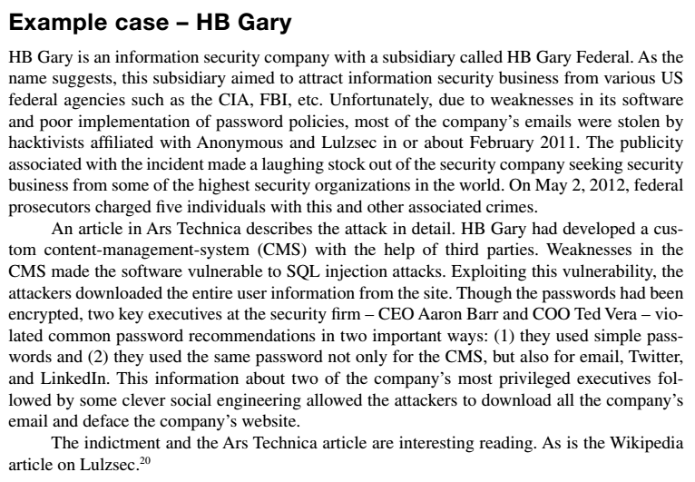
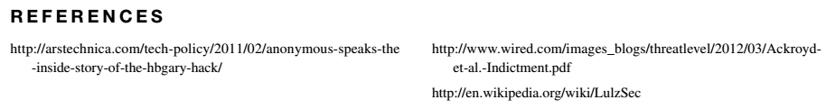
Example Case: HB Gary

Slide 34
Example Case Questions
What are the provisions of US Code sections 982(a) (2) (B) and 982 (b) (1)?
What specific offenses were committed by the attackers, as listed in the indictment?
Based on the incident, what specific policy recommendations would you recommend for the company to prevent damage from similar attacks in the future?

Slide 35
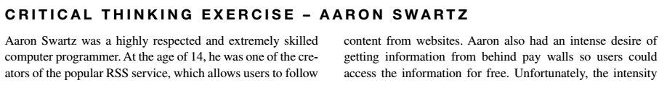
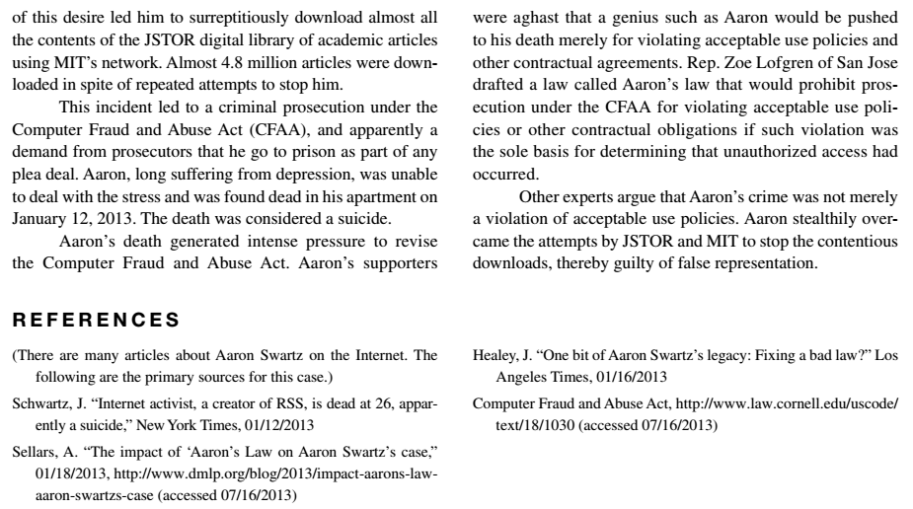
Critical Thinking Exercise

Slide 36
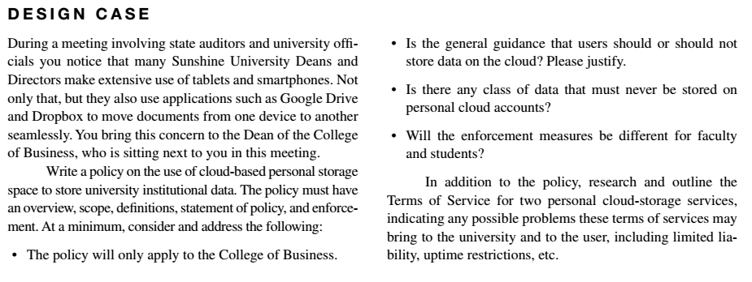
Design Case

Slide 37
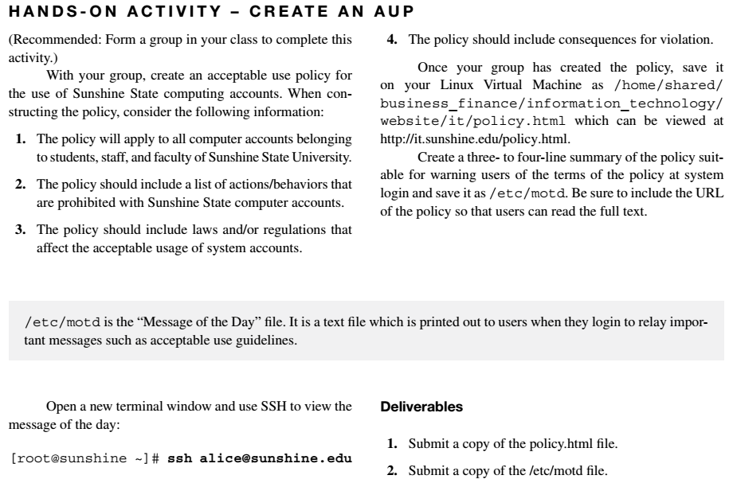
Hands-On Activity

Slide 38
Discussion 14
POST (due WED 11:59 pm CST): Read through the example case in this chapter on HB Gary and post your answer to the following questions:
What are the provisions of US Code sections 982(a) (2) (B) and 982 (b) (1)?
What specific offenses were committed by the attackers, as listed in the indictment?
RESPONSES (due FRI 11:59 pm CST): Respond to two of your peers. Based on their analysis of the incident, what specific policy changes would you recommend for the company to prevent damage from similar attacks in the future?

Slide 39
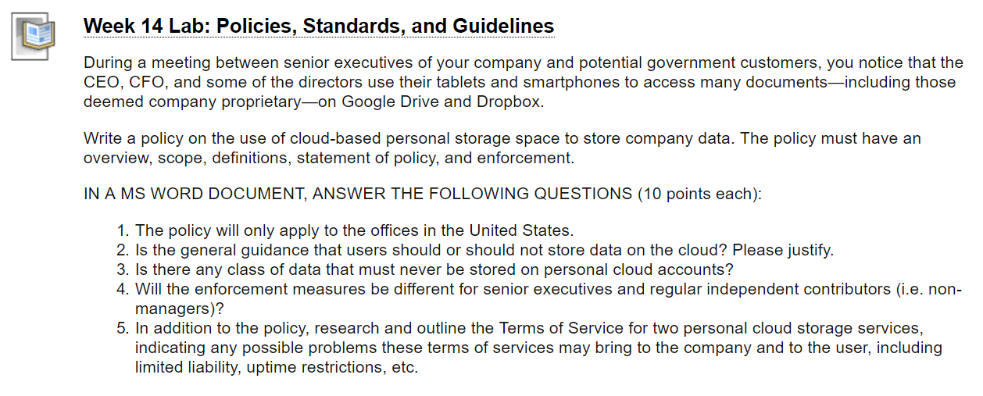
Homework Lab_14

Slide 40
Summary
Understand the difference between security and compliance requirements
Distinguish between policies, standards, and procedures
Understand the life-cycle of a policy
Identify a set of policies considered “a must” for any organization

Slide 41
For Next Week
# | Topic | Reading | Due 11:59 pm CST on Blackboard
15 | Course Summary & certification paths: The NIST 800-39 framework, Sarbanes-Oxley compliance | Agrawal 14 Other materials on Blackboard | W: Post F: Responses S: LAB_15

